Slide 1
BU Course Builder
Group 1 (BUAN) Natasya Liew: Team Leader Natthaphon Foithong: Design and Implementation Lead Ananya Singh: Security Lead Battal Cevik: QA Lead Poom Chantarapornrat: Requirement Lead Yu Jun Liu: Configuration Lead

Slide 2
Iteration 2 Key Updates
Finished the Python AI service implementation of the Functionalities
Finished the main Frontend implementation of Functionalities
Finished the implementation of the Database and created the final DB design and implementation for future works.
Set up BDD Framework using Cucumber and start the testing process
Set up the 3-tier: Main - Stage - Develop Workflow in GitHub
Integrated the Python AI service, SB backend, Database, and Frontend to a fully functional production environment
Applied User Authentication
Set up deployment to AWS using EC2 Instance

Slide 3
Introduction to BUAN
A chatbot-driven web application to assist students with academic advising.
Uses GPT-4o via Langchain API for personalized recommendations.
Frontend: React, Backend: Spring Boot & Python AI Service, Database: PostgreSQL.
AI-Driven: ChatGPT-4o via LangChain Chatbot
Customized Course recommendations builder based on student profiles.

Slide 4
Design Goals
Seamless chatbot interaction via real-time communication.
Modular architecture for easy maintenance and scalability.
Performance optimization with client-side and server-side caching.
Secure authentication using JWT tokens and authentication.

Slide 5
Software Architecture
Frontend: React/Vite with WebSocket integration
Backend: Spring Boot for authentication and chat handling
AI Layer: Python-based script using LangChain tooling for intelligent chatbot responses (supported by ChatGPT-4o)
Database: PostgreSQL for chat history and user data
CI/CD: Docker, GitHub Actions, AWS EC2 for deployment

Slide 6
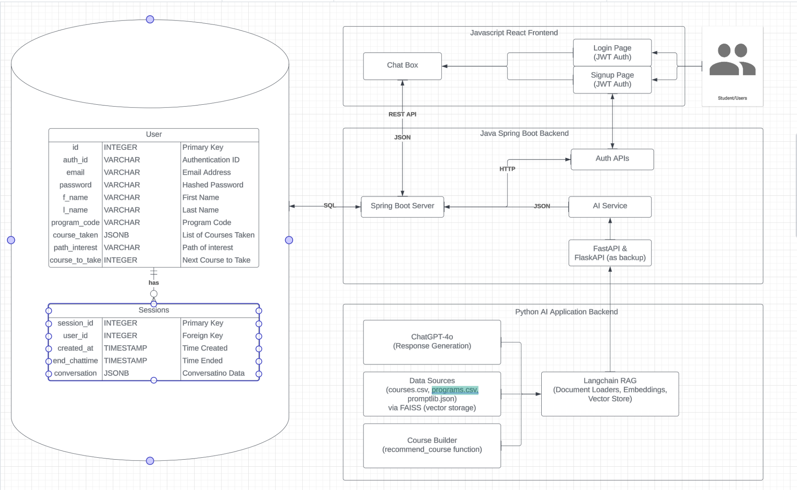
Architecture Diagram

Slide 7
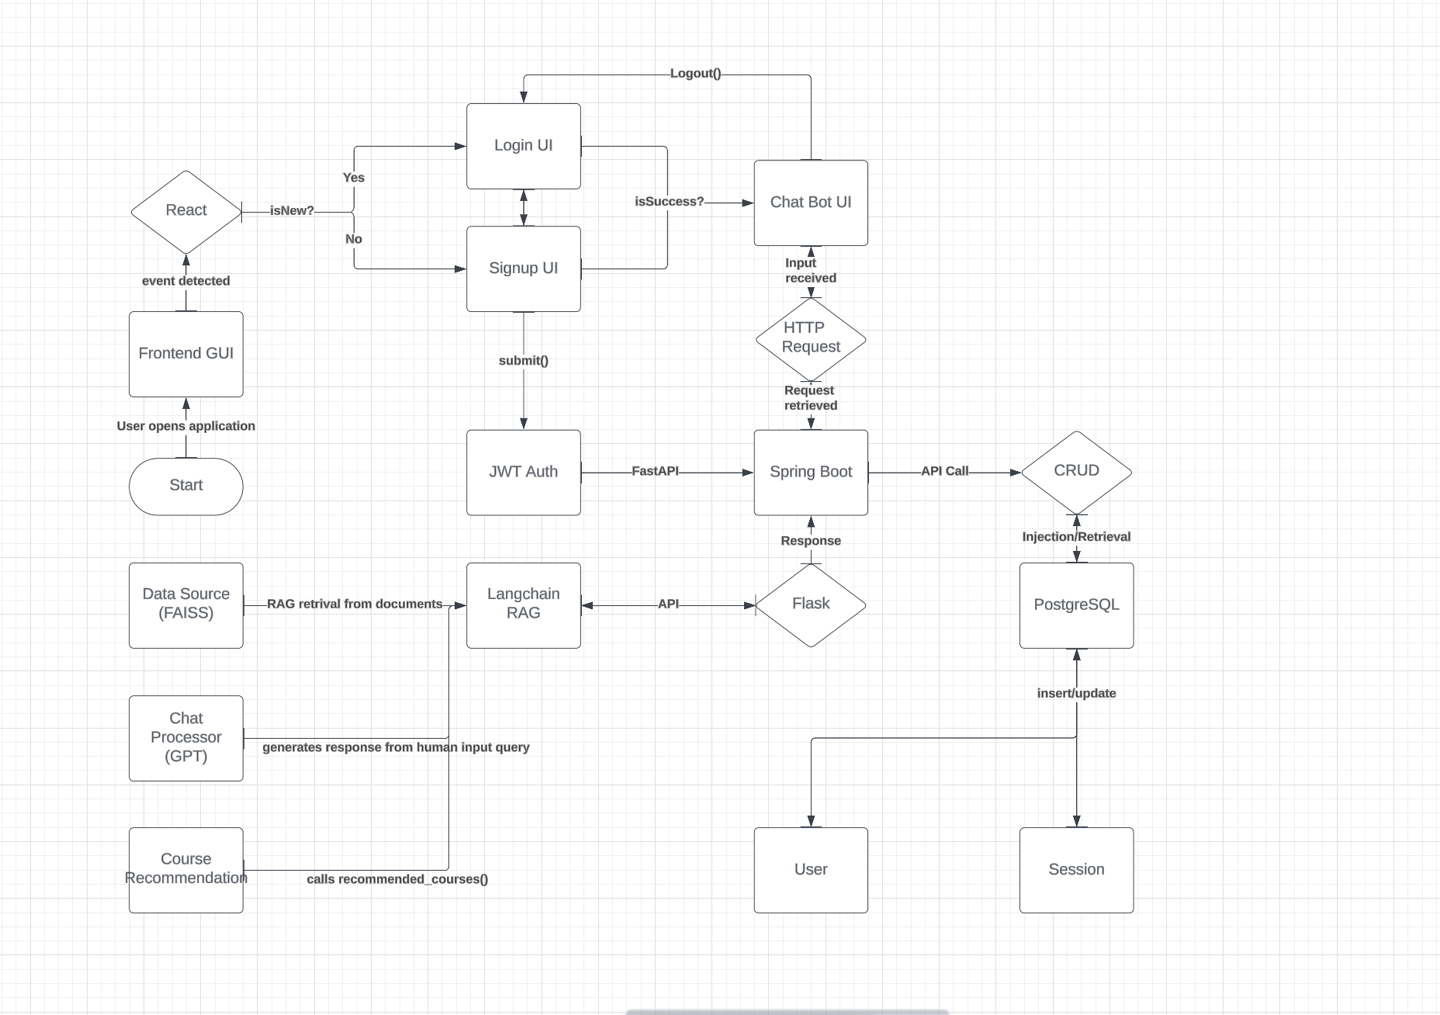
Process Flow Diagram

Slide 8
Frameworks and Libraries
Frontend: React.js, Vite, Axios, Material UI
Backend: Java (Spring Boot), Maven, JWT Tokens/Auth
AI Layer: Langchain, FastAPI, FlaskAPI, Pandas, ChatGPT-4o, FAISS (for vector storage)
Automation Testing: Selenium, Cucumber, TestNG, Maven, Rest Assured API

Slide 9
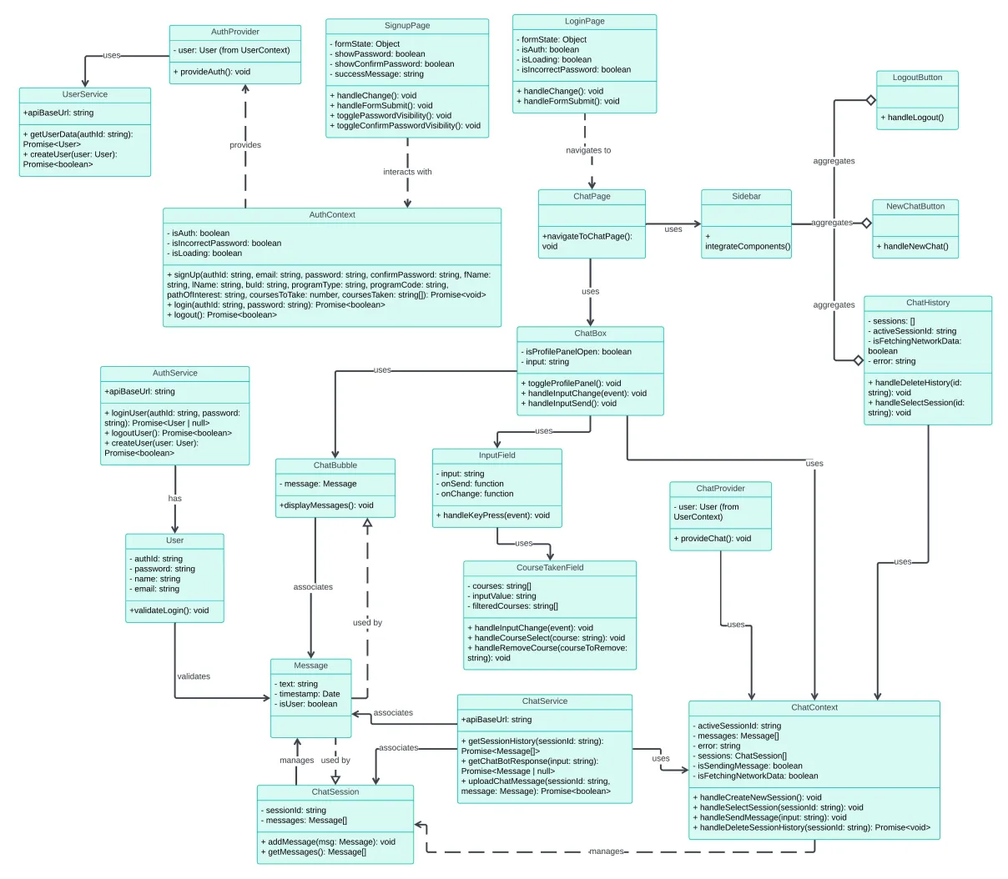
Class Diagram
Notes:
To update

Slide 10
UI Design Overview
Layout: Two-column, two-row structure
Left Column: Side panel for actions (New chat, end chat, email, share, print, logout)
Right Column: Chat interface for conversation
Key UI Components
Chat Interface:
Chat Window: Main area for conversation
Message Bubbles: Distinct bubbles for user (right) and bot (left) messages
Input Field: Text box, send button, optional Grammarly check
Action Buttons:
End Chat: Logout and close session
Email Chat History: Send transcript via email
Share Chat: Generate shareable link
Print History: Prepare chat for printing

Slide 11
UI Design Colors and Typography
Color Palette:
#E54500 (Orange-red)
#675DFF (Blue)
#FFD0BC (Light orange)
#FFFFFF (White)
Typography: Outfit, San-serif

Slide 12
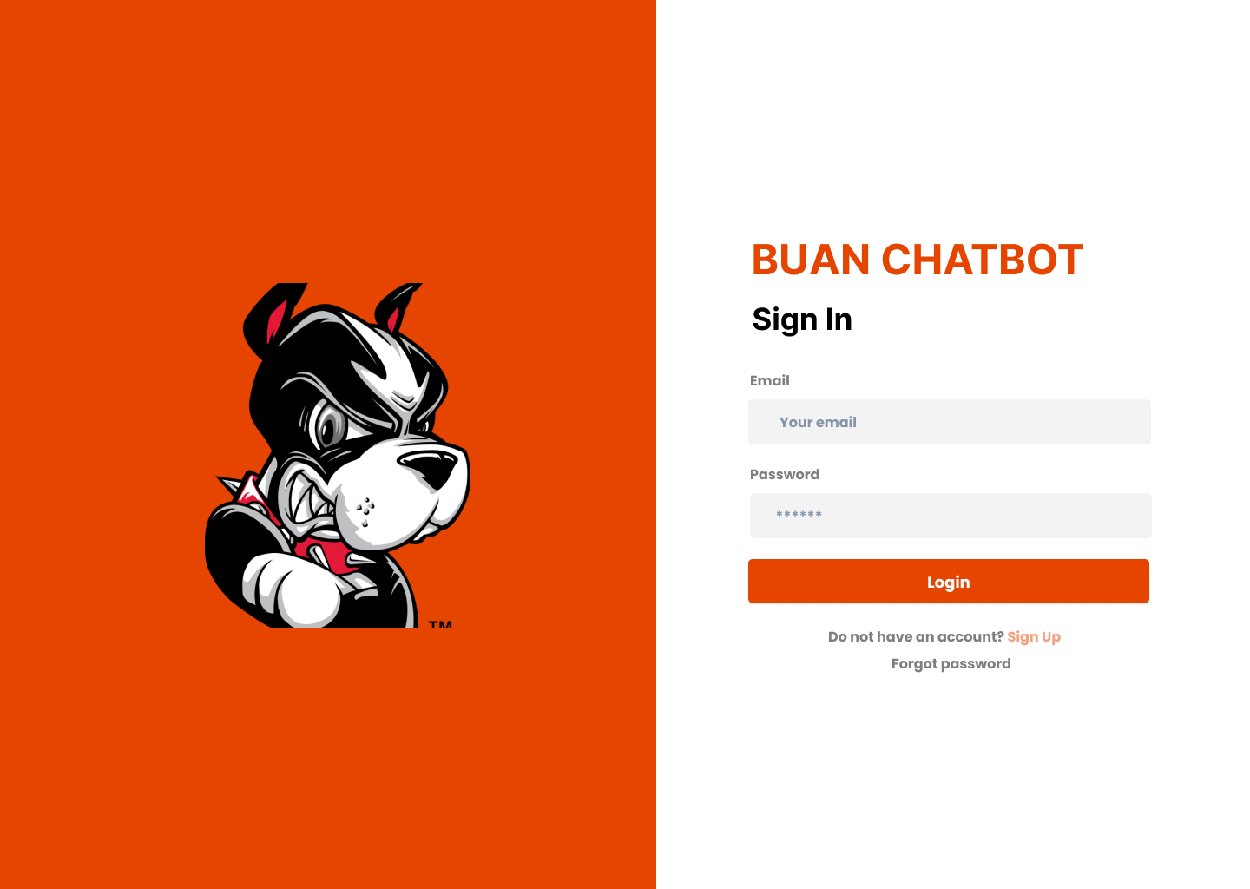
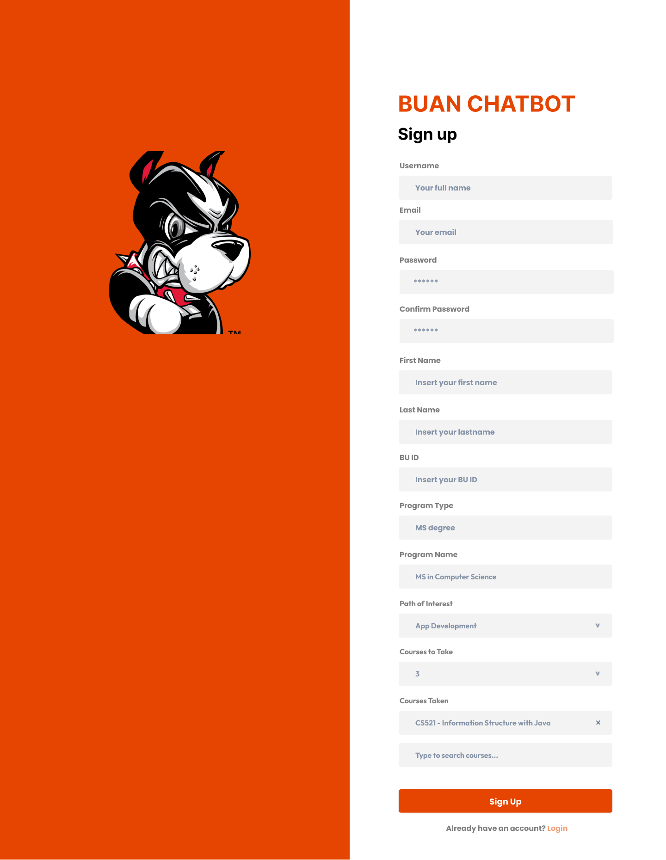
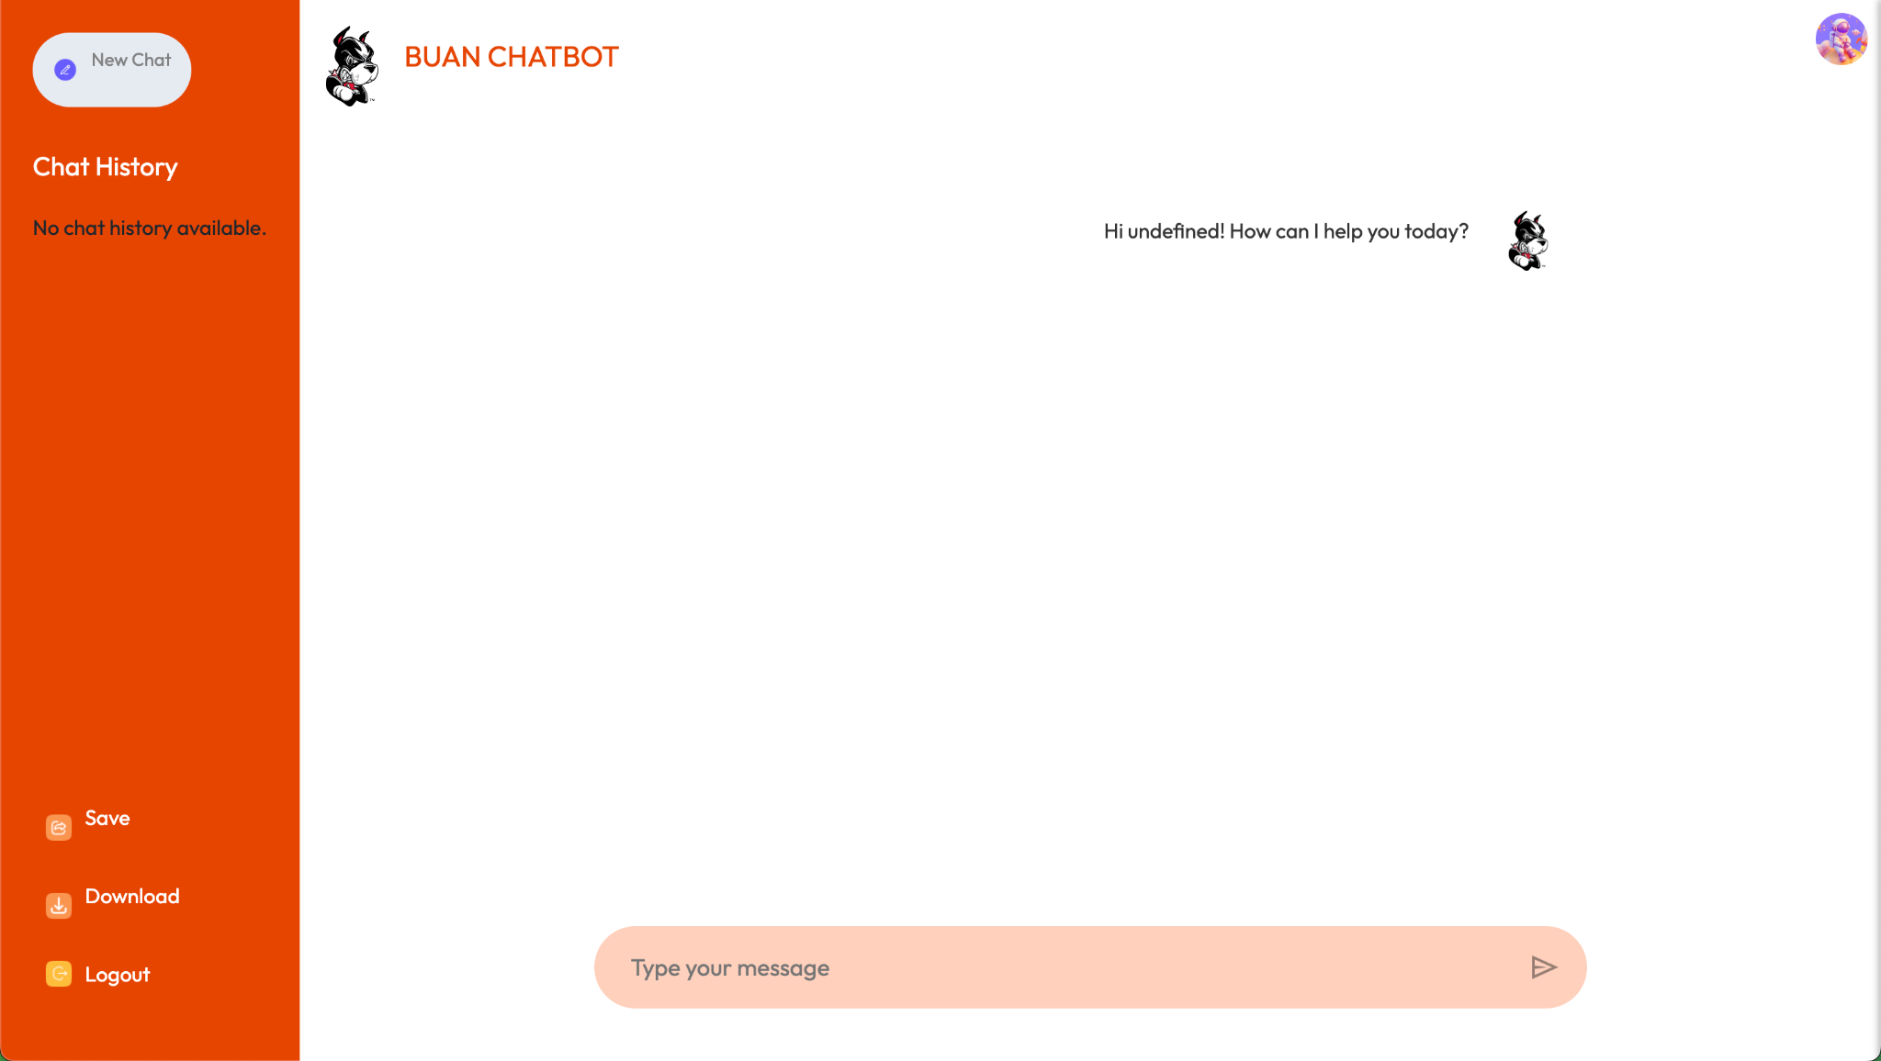
Mockup Design
Notes:
To update

Slide 13
Database Design
Users Table
user_id: Primary key, uniquely identifying each user.
auth_id: Unique identifier for authentication.
email: User email for authentication.
password_hash: Hashed password for security.
f_name: First name of user.
l_name: Last name of user.
program_code: Academic program code.
course_taken: JSONB list of completed courses.
path_interest: User's academic/career interests.
course_to_take: Next planned course.

Slide 14
Database Design
Sessions Table
session_id: Primary key, uniquely identifying each session.
user_id: Foreign key linking to Users table.
created_at: Timestamp for session start (default: current timestamp).
end_chattime: Timestamp for when a session ends.
conversation: JSONB field for chat history.

Slide 15
Summary of Changes - Database
- Replaced the original `PostgreSQL Collections` section with the updated `CREATE TABLE` statements and stored procedures.
- Added relevant attributes and descriptions to clarify the purpose and structure of the `users` and `sessions` tables.
- Maintained the original format for easy readability.

Slide 16
Security Design
User Authentication: JWT authentication integration for secure login.
Sensitive Data Handling: Minimization and encryption of PII, chat logs retention.
Session Management: Automatic logout after inactivity.

Slide 17
Business Logic and Key Algorithms
Program and Course Information Retrieval: Query programs and courses for detailed information.
Course Selection Assistance: Recommend courses based on user’s academic interests and history.
Personalized Chat History: Cache and retrieve past interactions to maintain context.
Complex Query Handling: Address multifaceted queries with custom logic.

Slide 18
Algorithm Overview: Course Builder
Input
Programs Data: Reads from CSV to create a dictionary of program attributes (core/elective courses, prerequisites).
Courses Data: Reads from CSV to generate a dictionary of course details.
Student Profile: Contains completed courses, declared interests, and desired courses to take.

Slide 19
Algorithm Overview: Course Builder (cont…)
Core Functions
CourseTree Class: Manages course recommendations via a tree structure.
add_branch: Adds course sequences to the tree while avoiding completed or skipped courses.
build_mssd_tree: Constructs a course tree based on student interests and completed courses.
recommend_courses: Traverses the tree to recommend courses for the next semester.

Slide 20
Algorithm Overview: Course Builder (cont…)
Algorithm Operation
Tree Construction: Builds a course tree dynamically based on the student's path of interest.
Recommendation Process: Identifies courses not yet taken and recommends them in the correct sequence.
Time Complexity
Tree Construction & Recommendation: Approximately O(n), where n is the total number of courses.

Slide 21
Algorithm Overview: Course Builder (cont…)
Outputs
Program and course data dictionaries.
Recommended course list based on the student’s profile.

Slide 22
Design Patterns
Factory Method Pattern
Purpose: Creates service instances based on user requests (e.g., Course Recommendations, Course Information).
Implementation: ChatServiceFactory dynamically generates appropriate service classes.
Observer Pattern
Purpose: Ensures real-time updates across chatbot components.
Implementation: ChatSession notifies observers (e.g., ChatWindow, ChatHistoryLogger) of changes.

Slide 23
Testing and Deployment
Unit Testing: React, Spring Boot, Python AI modules tested individually.
Integration Testing: Ensures seamless communication between the frontend, backend, and AI services.
Regression Testing: Full application tested to ensure all features work as intended.
Automated Testing: Selenium for UI testing, PyTest for backend.
Deployment: AWS EC2 Instance for production deployment

Slide 24
Chatbot Model
ChatGPT 4.0 via Langchain API: Powers course recommendations and information lookup.
Functionality:
Course Recommendations: Analyzes student data to suggest upcoming semester courses.
Course & Program Information Lookup: Provides details about specific courses on request.
Other Queries on Student Life and BU MET CS department: Provides responses regarding student life, work-academic balance, and other questions relevant to the needs of students within the BU MET CS department.

Slide 25
Chatbot Model (continued)
User Interaction Flow
User logs in with username.
Inputs profile parameters (program, career path interests, courses taken, number of course taken for the next semester).
Receives personalized course recommendations.
Can query further course details.
Chat history is cached for future reference.
Ability to request alternate personalize course recommendations at command if user is not satisfied with previous recommendations
.

Slide 26
Tooling
JWT Authentication: We implemented JWT (JSON Web Tokens) for secure user authentication. This method allows for stateless authentication, improving the user experience by enabling users to remain logged in across sessions without needing to constantly re-enter their credentials.
Fetch API: The Fetch API is employed for making network requests to the server. It allows our application to request and retrieve data from the backend efficiently, handling both requests for course recommendations and information lookups.
Flask API: Our backend is built using Flask, a lightweight web framework for Python. The Flask API serves as the intermediary between the chatbot and the database, managing requests for course data and user authentication.
FastAPI: We also utilize FastAPI, a modern web framework for building APIs with Python. FastAPI is known for its high performance, built-in data validation, and automatic generation of OpenAPI documentation. It enables asynchronous programming, making our API calls faster and more efficient, especially under load.
Cucumber Testing: We use Cucumber for behavior-driven development (BDD) testing. This tool allows us to write acceptance tests in plain language, facilitating communication between developers, testers, and non-technical stakeholders. It helps ensure our application meets business requirements and performs as expected.
Automation: Automation tools and scripts are integrated into our workflow to streamline various processes, including testing, deployment, and continuous integration. Automation reduces human error and increases efficiency, allowing developers to focus on building features.
JIRA: We utilize JIRA for project management and tracking tasks. It helps organize work into manageable segments, assign responsibilities, and monitor progress, ensuring that all team members are aligned on goals and deadlines.
GitHub: GitHub serves as our version control system, where all project code is stored, tracked, and managed. It facilitates collaboration among team members through features like branching, pull requests, and issue tracking.
Axios: Axios is a promise-based HTTP client used in our frontend for making requests to the Flask and FastAPI backends. It simplifies the process of handling asynchronous requests and allows for easy integration of error handling and response data management.
Captcha: We integrated CAPTCHA into the user authentication process to add an extra layer of security. This helps prevent automated attacks and ensures that only legitimate users can access the system.
Langchain: Langchain is the framework we use to connect our chatbot with the ChatGPT model. It provides the necessary tools and abstractions to manage interactions, enabling us to build robust conversational agents.
Docker: Docker is used to containerize our application, ensuring that it runs consistently across different environments. This makes deployment easier and enhances scalability, allowing our application to handle varying loads.
AWS: We deploy our application on Amazon Web Services (AWS), leveraging its robust infrastructure for hosting, storage, and computing. AWS allows us to scale our resources dynamically based on demand and provides various services that enhance our application's capabilities.

Slide 27
Risk Management
Risk: Lack of motivation, procrastination, inconsistent work output, or team members dropping out could hinder progress and lead to missed deadlines.
Risk: Unclear requirements, frequent changes, or uncontrolled expansion of project scope could lead to delays and inefficiencies.
Risk: Integration challenges, failed CI pipeline runs, or inconsistent development and production environments could cause delays and regression.
Risk: Insufficient testing could lead to undetected bugs or issues in production, reducing system reliability.
Risk: Team members may face challenges using new technologies like Docker, FastAPI, PostgreSQL, GPT-4, or Spring Boot, leading to delays in task completion.
Risk: Miscommunication, avoidance of issues, or poor collaboration can lead to duplicate work, missed deadlines, or incomplete tasks.
Risk: Some team members may take on more work than others, leading to burnout or reduced quality of work output.
Risk: Single access to the OpenAI API key owned by Poom could create a bottleneck, limiting testing opportunities for AI-related services.
Risk: Unexpected emergencies or busy work schedules might limit team members' ability to meet project deadlines.

Slide 28
Team Github and UI Mockups
https://github.com/BUMETCS673/seprojects-cs673olf24team1
https://www.figma.com/design/gjNG1bADwnFxgDqclMwQVQ/Chat-AI-Bot---673ONE---final-mockup?node-id=0-1

Slide 29
FrontEnd Functionalities
User logging in and signing up using JWT Authentication for security authentication
Easy to use GUI to interact with the BUAN chatbot
Ability to see past chat history conversation rendered in the GUI.
Able to download chat conversation into a pdf file format (coming in iteration 3)
Ability to save chat with BUAN chatbot for future reference

Slide 30
Changes from Last Iteration - Frontend
Now, the main functionalities of the frontend code are functional and integrated to the SB backend and database.
TODO for next iteration: To add `download chat` features.

Slide 31
Python AI Service Functionalities
Using NLP to make conversation between chatbot to user smoother with a better ux experience.
Ability to build course recommendation for the next semester based on student history and preference.
Ability to ask chatbot about courses and programs from the BU MET CS department
Ability to ask student and program related questions about BU, program, and living in Boston.
Ability to ask who to contact if the chatbot is unable to answer the users’ question.

Slide 32
Changes from Last Iteration - Python AI service
Now, the scope of responses that the BUAN chatbot can ask is larger. From just answering about programs and courses and generating the course recommended, the chatbot can now answer logic-based questions about the registration process, visa issues, work and relationship queries, and contact person if the chatbot still can’t answer the questions.

Slide 33
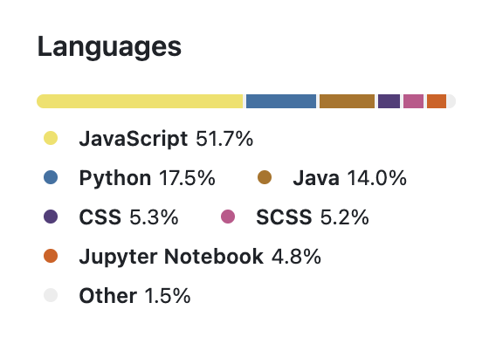
SB Backend Functionality
Efficient integration between the many services and APIs.
Having a middleware to parse and link the different variable names between the different services.

Slide 34
Changes from Last Iteration - SB backend
Now, the SB backend is connected to the Frontend, the demo is no longer static. We also implemented user implementation.
TODO for next iteration: To add security layer. Then after to deploy to AWS using EC2 Instance.

Slide 35
Postgres Database
Allowing JSONB storing for easy usage by the Springboot Backend.
Having stored procedure to cache frequently used query to increase insertion and retrieval performance.

Slide 36
Changes from Last Iteration - Database
Now, the database can do stored procedures for quick response retrieval.

Slide 37
CI/CD Integration Updates
We have a 3-tiers workspace(Develop, Stage, Production).
Linting and Formatting Requirements
Deployed AWS EC2 instance

Slide 38
QA/Testing Updates
Using BDD Framework with Selenium and Cucumber for UI Testing
Using Rest Assured for api testing
Testing for all feature functionalities for the product
UI and API testing framework set up and added functionalities now.

Slide 39
Plan for Iteration 3
Iteration Summary
Iteration 0:
Planning architecture design
Setting up requirements
Defining application features
Establishing team culture and work routine
Iteration 1:
Adding Chatbot implementation
Adding custom course recommendation algorithm
Setting up SpringBoot Backend
Setting up Frontend React and finishing the Chatpage UI components
Iteration 2:
Finishing Frontend main functionalities, saving chat into the database, signup/login functionality using JWT Auth
Adding promptlib.json as a RAG and increasing the scope of queries to accept larger query possibilities
Setting up AWS EC2 Instance for iteration 3
Setting up QA/Testing BDD framework and unit testing
Fully end-to-end integration between all services
Adding more security layer to the product
Adding the `download chat` functionality
Adding more testing and QA
Adding more linting/formatting measures
Making the coursebuilder class to be less static and possibly expand to allow other certificates and programs be available. (Attempt)
Cleaning and Annotating the code to allow easy collaboration among development team members.
Adding Redux implementation
Notes:
Iteration 0 Link: https://youtu.be/g12YR7aotc0?feature=shared
Iteration 1 Link: https://cdnapisec.kaltura.com/html5/html5lib/v2.101/mwEmbedFrame.php/p/2159741/uiconf_id/45028821/entry_id/1_2eq2v3jm?wid=_2159741&iframeembed=true&playerId=kaltura_player&entry_id=1_2eq2v3jm&flashvars[streamerType]=auto&amp;flashvars[localizationCode]=en&amp;flashvars[sideBarContainer.plugin]=true&amp;flashvars[sideBarContainer.position]=left&amp;flashvars[sideBarContainer.clickToClose]=true&amp;flashvars[chapters.plugin]=true&amp;flashvars[chapters.layout]=vertical&amp;flashvars[chapters.thumbnailRotator]=false&amp;flashvars[streamSelector.plugin]=true&amp;flashvars[EmbedPlayer.SpinnerTarget]=videoHolder&amp;flashvars[dualScreen.plugin]=true&amp;flashvars[hotspots.plugin]=1&amp;flashvars[Kaltura.addCrossoriginToIframe]=true&amp;&wid=1_3j73gq8j
Iteration 2 Link: https://www.loom.com/share/ff29ccbb2a354c49a3b8b4c4194337ec?sid=9892123a-aee8-4884-8156-ec409955fde2
Iteration 3 Link: [coming soon]

Slide 40
Presentation Video Links
Iteration 0 Link: https://youtu.be/g12YR7aotc0?feature=shared
Iteration 1 Link: https://cdnapisec.kaltura.com/html5/html5lib/v2.101/mwEmbedFrame.php/p/2159741/uiconf_id/45028821/entry_id/1_2eq2v3jm?wid=_2159741&iframeembed=true&playerId=kaltura_player&entry_id=1_2eq2v3jm&flashvars[streamerType]=auto&amp;flashvars[localizationCode]=en&amp;flashvars[sideBarContainer.plugin]=true&amp;flashvars[sideBarContainer.position]=left&amp;flashvars[sideBarContainer.clickToClose]=true&amp;flashvars[chapters.plugin]=true&amp;flashvars[chapters.layout]=vertical&amp;flashvars[chapters.thumbnailRotator]=false&amp;flashvars[streamSelector.plugin]=true&amp;flashvars[EmbedPlayer.SpinnerTarget]=videoHolder&amp;flashvars[dualScreen.plugin]=true&amp;flashvars[hotspots.plugin]=1&amp;flashvars[Kaltura.addCrossoriginToIframe]=true&amp;&wid=1_3j73gq8j
Iteration 2 Link: https://www.loom.com/share/0f89d6608282436ebb194db4e7251023
Iteration 3 Link: [coming soon]

